Slide 1
UNIT 5

Slide 2
Java JDBC
JDBC stands for Java Database Connectivity. JDBC is a Java API to connect and execute the query with the database. It is a part of JavaSE (Java Standard Edition). JDBC API uses JDBC drivers to connect with the database. There are four types of JDBC drivers:
1) JDBC-ODBC Bridge Driver
2) Native Driver
3) Network Protocol Driver
4)Thin Driver

Slide 3
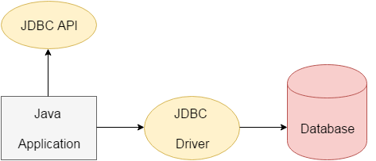
We can use JDBC API to access tabular data stored in any relational database. By the help of JDBC API, we can save, update, delete and fetch data from the database. It is like Open Database Connectivity (ODBC) provided by Microsoft.
The java.sql package contains classes and interfaces for JDBC API.

Slide 4
Interfaces
Driver interface
Connection interface
Statement interface
PreparedStatement interface
CallableStatement interface
ResultSet interface
ResultSetMetaData interface
DatabaseMetaData interface
RowSet interface
classes
DriverManager class
Blob class
Clob class
Types class

Slide 5
Why Should We Use JDBC
Before JDBC, ODBC API was the database API to connect and execute the query with the database. But, ODBC API uses ODBC driver which is written in C language (i.e. platform dependent and unsecured). That is why Java has defined its own API (JDBC API) that uses JDBC drivers (written in Java language).
We can use JDBC API to handle database using Java program and can perform the following activities:
Connect to the database
Execute queries and update statements to the database
Retrieve the result received from the database.

Slide 6
JDBC Driver
JDBC Driver is a software component that enables java application to interact with the database. There are 4 types of JDBC drivers:
1) JDBC-ODBC bridge driver
2) Native-API driver (partially java driver)
3) Network Protocol driver (fully java driver)
4) Thin driver (fully java driver)

Slide 7
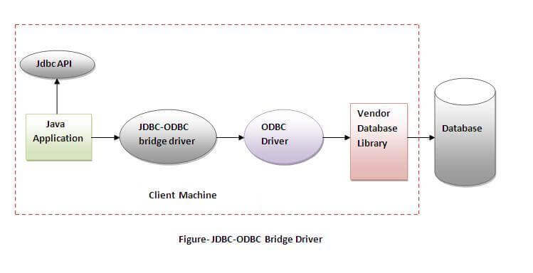
1) JDBC-ODBC bridge driver
The JDBC-ODBC bridge driver uses ODBC driver to connect to the database. The JDBC-ODBC bridge driver converts JDBC method calls into the ODBC function calls.

Slide 8
Advantages:
1) easy to use.
2) can be easily connected to any database.
Disadvantages:
1) Performance degraded because JDBC method call is converted into the ODBC function calls.
2) The ODBC driver needs to be installed on the client machine.

Slide 9
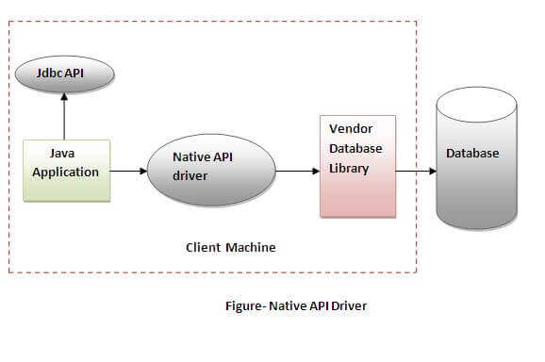
2) Native-API driver
The Native API driver uses the client-side libraries of the database. The driver converts JDBC method calls into native calls of the database API. It is not written entirely in java.

Slide 10
Advantage:
performance upgraded than JDBC-ODBC bridge driver.
Disadvantage:
1) The Native driver needs to be installed on the each client machine.
2) The Vendor client library needs to be installed on client machine.

Slide 11
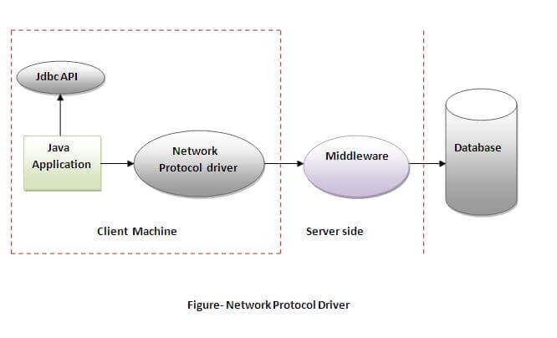
3) Network Protocol driver
The Network Protocol driver uses middleware (application server) that converts JDBC calls directly or indirectly into the vendor-specific database protocol. It is fully written in java.

Slide 12
Advantage:
No client side library is required because of application server that can perform many tasks like auditing, load balancing, logging etc.
Disadvantages:
1) Network support is required on client machine.
2) Requires database-specific coding to be done in the middle tier.
3) Maintenance of Network Protocol driver becomes costly because it requires database-specific coding to be done in the middle tier.

Slide 13
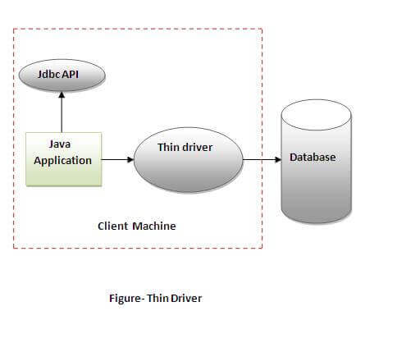
4) Thin driver
The thin driver converts JDBC calls directly into the vendor-specific database protocol. That is why it is known as thin driver. It is fully written in Java language.

Slide 14
Advantage:
1) Better performance than all other drivers.
2) No software is required at client side or server side.
Disadvantage:
Drivers depend on the Database.

Slide 15
Java Database Connectivity with 5 Steps
There are 5 steps to connect any java application with the database using JDBC. These steps are as follows:
1) Register the Driver class
2) Create connection
3) Create statement
4) Execute queries
5) Close connection

Slide 16
1) Register the driver class
The forName() method of Class is used to register the driver class. This method is used to dynamically load the driver class.
Syntax of forName() method
public static void forName(String className)throws ClassNotFoundException
Example to register the OracleDriver class
Here, Java program is loading oracle driver to esteblish database connection.
Class.forName("oracle.jdbc.driver.OracleDriver");

Slide 17
2) Create the connection object
The getConnection() method of DriverManager class is used to establish connection with the database.
Syntax of getConnection() method
1) public static Connection getConnection(String url)throws SQLException
2) public static Connection getConnection(String url,String name,String password) throws SQLException
Example to establish connection with the Oracle database
Connection con=DriverManager.getConnection(
"jdbc:oracle:thin:@localhost:1521:xe","system","password");

Slide 18
3) Create the Statement object
The createStatement() method of Connection interface is used to create statement. The object of statement is responsible to execute queries with the database.
Syntax of createStatement() method
public Statement createStatement()throws SQLException
Example to create the statement object
Statement stmt=con.createStatement();

Slide 19
4) Execute the query
The executeQuery() method of Statement interface is used to execute queries to the database. This method returns the object of ResultSet that can be used to get all the records of a table.
Syntax of executeQuery() method
public ResultSet executeQuery(String sql)throws SQLException
Example to execute query
ResultSet rs=stmt.executeQuery("select * from emp");
while(rs.next()){
System.out.println(rs.getInt(1)+" "+rs.getString(2));
}

Slide 20
5) Close the connection object
By closing connection object statement and ResultSet will be closed automatically. The close() method of Connection interface is used to close the connection.
Syntax of close() method
public void close()throws SQLException
Example to close connection
con.close();

Slide 21
Java Database Connectivity with MySQL
To connect Java application with the MySQL database, we need to follow 5 following steps.
In this example we are using MySql as the database. So we need to know following informations for the mysql database:
Driver class: The driver class for the mysql database is com.mysql.jdbc.Driver.
Connection URL: The connection URL for the mysql database is jdbc:mysql://localhost:3306/sonoo where jdbc is the API, mysql is the database, localhost is the server name on which mysql is running, we may also use IP address, 3306 is the port number and sonoo is the database name. We may use any database, in such case, we need to replace the sonoo with our database name.
Username: The default username for the mysql database is root.
Password: It is the password given by the user at the time of installing the mysql database. In this example, we are going to use root as the password.

Slide 22
import java.sql.*;
class MysqlCon{
public static void main(String args[]){
try{
Class.forName("com.mysql.jdbc.Driver");
Connection con=DriverManager.getConnection(
"jdbc:mysql://localhost:3306/sonoo","root","root");
//here sonoo is database name, root is username and password
Statement stmt=con.createStatement();
ResultSet rs=stmt.executeQuery("select * from emp");
while(rs.next())
System.out.println(rs.getInt(1)+" "+rs.getString(2)+" "+rs.getString(3));
con.close();
}catch(Exception e){ System.out.println(e);}
}
}

Slide 23
To connect java application with the mysql database, mysqlconnector.jar file is required to be loaded.
download the jar file mysql-connector.jar

